Slide 1

DSA
Week 6
Recursion
Data Structures and Algorithms (DSA)
Prescribed Module/Elective
Diploma in IT / ISF
Year 2 (2017/18), Semester 4

Slide 2
Topics
Introduction of Recursion
Constructing Recursive Solutions
A Poor Solution to a Simple Problem
Recursion in Array Processing
A Simple Solution to a Difficult Problem
Recursion and Efficiency
Recursion VS Iteration

Slide 3
References
1. Data Abstraction and Problem Solving with C++ 5th Edition
☞ chapter 2

Slide 4

1. What is Recursion?
Recursion is a extremely powerful programming technique employed to solve problems.
Breaks a problem into smaller but similar problem size which may be easier to solve
-> Divide and Conquer
At the end of the ‘division’ of the problem, you reach a smallest problem where by answer is trivial
Using that answer enables you to solve the previous problems

Slide 5
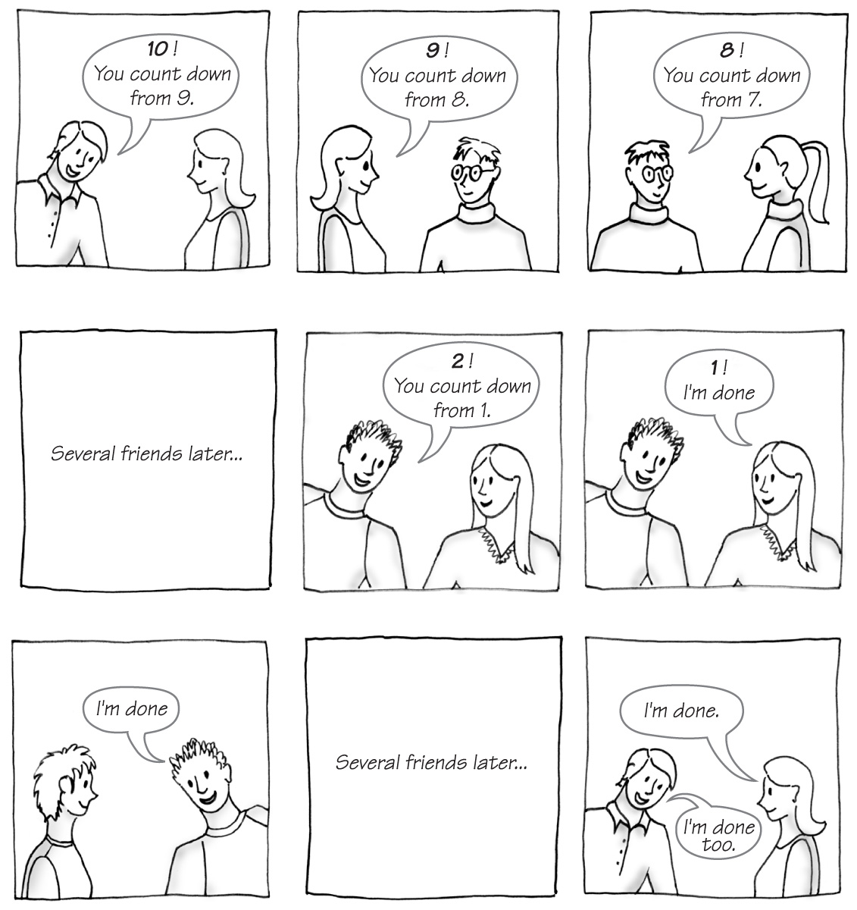
What is Recursion?
Carrano, Data Structures and Abstractions with Java, Second Edition, (c) 2007 Pearson Education, Inc. All rights reserved. 0-13-237045-X

Slide 6
What is Recursion?
In programming, recursion takes the form of a function/method that calls itself
-> Recursive function/method
int findFact(int n)
{
if (n == 0)
return 1;
else
return n * findFact(n-1);
} // end fact
Each time function calls a copy of itself to work on smaller problem -> Recursive Call/ Recursion Step

Slide 7
2. Constructing Recursive Solutions
4 Questions:
How to define the problem in terms of a smaller and similar problem?
Does each recursive call reduce size of problem?
What instance of the problem serve as base case?
4. As the problem size reduces, will you reach the base case?

Slide 8
Constructing Recursive Solutions
Structure of Recursive Function:
Function prototype must provide parameter(s)
Divides problem into 2 or more pieces
Division via selection control structures
One piece that you know how to do
☞ Base case
The other piece(s) that you don’t know how to do yet
Take steps towards the base case to solve the problem
Recursion step usually includes a return
☞ Returns program control to caller to be combined with other pieces

Slide 9
Constructing Recursive Solutions
Problem(example of a recursive value-returning function):
Compute the factorial of an integer n (n!)
Possible Iterative Definition:
factorial(n) = n * (n – 1) * (n – 2) * … * 1
for any integer n > 0
factorial(0) = 1
int findFact(int n)
{
int result = 1;
for(int i = n; i >= 1; i--)
result *= i;
return result;
}

Slide 10
Constructing Recursive Solutions
Problem: Compute the factorial of an integer n (n!)
Possible Recursive Definition:
1 if n = 0
n * factorial(n–1) if n > 0
factorial(n)
int findFact(int n)
{
if(n == 0)
return 1;
else
return n * findFact(n-1);
}

Slide 11
Constructing Recursive Solutions
In fact, the expression of a factorial(n) in terms of factorial (n-1 is an example of Recurrence Relation in Mathematics.
Recurrence Relation:
A mathematical formula that generates the terms in a sequence from previous terms
Recurrence relation for factorial(n):
factorial(n) = n * [(n – 1) * (n – 2) * … * 1] = n * factorial(n – 1)

Slide 12
Tracing a Recursive Function
A box trace is a systematic way to trace the actions of a recursive function, very useful for debugging recursive functions.
Corresponds to an activation record
Contains a function’s local environment/ context at the time of and result of call to the function.
When a call is made to a function, we say the context/ local environment of current function is switched to new one.
During context switching, previous context must be saved so that it can be reinstated upon return from function call.

Slide 13
Tracing a Recursive Function
e.g.
int findFact(int n)
{
if (n == 0)
return 1;
else
return n * findFact(n-1);
} // end fact
findFact(1):
n = 1
return 1 * findFact(0)
findFact(2):
n = 2
return 2 * findFact(1)
findFact(2):
n = 2
return 2 * findFact(1)
findFact(3):
n = 3
return 3 * findFact(2)
findFact(3):
n = 3
return 3 * findFact(2)
findFact(3):
n = 3
return 3 * findFact(2)

Slide 14
Tracing a Recursive Function
findFact(0):
n = 0
return 1
findFact(1):
n = 1
return 1 * findFact(0)
findFact(1):
n = 1
return 1 * 1 = 1
findFact(2):
n = 2
return 2 * findFact(1)
findFact(2):
n = 2
return 2 * findFact(1)
findFact(2):
n = 2
return 2 * 1 = 2
findFact(3):
n = 3
return 3 * findFact(2)
findFact(3):
n = 3
return 3 * findFact(2)
findFact(3):
n = 3
return 3 * findFact(2)
findFact(3):
n = 3
return 3 * 2 = 6

Slide 15
Tracing a Recursive Function
A Box Trace/ Activation Record consists of:
Input parameters into the function
Local variables in the function
Placeholder for the value returned by each recursive call from the current box
Return value of the function
findFact(3):
n = 3
return 3 * findFact(2)

Slide 16
Constructing Recursive Solutions
Writing Invariants:
Equally important as writing them for iterative functions
If precondition is violated, function would not behave correctly.
/** @ pre n must be greater or equal to 0.
*** @ return The factorial of n */
int findFact(int n)
{
if(n == 0)
return 1;
else //Invariant: n > 0, so n-1 >= 0
//Thus findFact(n-1) returns (n-1)!
return n * findFact(n-1); //n * (n-1)! is n!
}
For the above example, there will be infinite recursive calls if precondition is violated because the function never reaches the base case.

Slide 17
Constructing Recursive Solutions
Problem (example of a Recursive void function):
Writing a String Backward
Given an input string, print the characters in a backward manner
Which of them works??
//stripping away last character
writeBackward(string s)
if(string is empty)
do nothing – this is the base case
else
{
write the last character of s
writeBackward(s minus its last character)
}
Can you derive the box trace of the above function?

Slide 18
Constructing Recursive Solutions
//stripping away first character
writeBackward1(string s)
if(string is empty)
do nothing – this is the base case
else
{
write the first character of s
writeBackward1(s minus its first character)
}
//stripping away first character
writeBackward2(string s)
if(string is empty)
do nothing – this is the base case
else
{
writeBackward2(s minus its first character)
write the first character of s
}
Download from MEL

Slide 19
3. A Poor Solution to Simple Problem - Fibonacci
Problem:
Multiplying Rabbits
How many pairs of rabbits are alive in month n?
Some prior facts:
Rabbits never die
A rabbit reaches sexual maturity exactly two months after birth, that is, at the beginning of its third month of life
Rabbits are always born in male-female pairs. At the beginning of every month, each sexually mature male-female pair gives birth to exactly one male-female pair

Slide 20
A Poor Solution to Simple Problem - Fibonacci
Month 0: 1 pair, the original rabbits
Month 1: 1 pair still, because the rabbits are not yet sexually mature
Month 2: 2 pairs; the original pair has reached sexual maturity and
has given birth to a second pair
Month 3: 3 pairs; the original pair has given birth again, but the pair
born at the beginning of month 3 are not sexually mature
Month 4: 5 pairs; all rabbits alive in month 3 (2 pairs) are now
sexually mature. Add their offspring to those pairs alive in
month 4 (3 pairs) to yield 5 pairs.
Month 5: 8 pairs; 3 newborn pairs from the pairs alive in month 4
plus 5 pairs alive in month 5

Slide 21
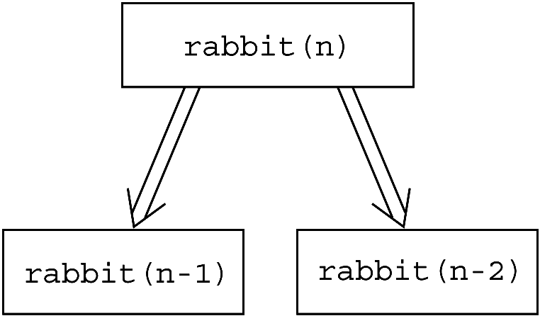
A Poor Solution to Simple Problem - Fibonacci
Recurrence relation for the problem:
rabbit(n) = rabbit(n – 1) + rabbit(n – 2)
Copyright © 2007 Pearson Education, Inc. Publishing as Pearson Addison-Wesley. Ver. 5.0.

Slide 22
A Poor Solution to Simple Problem - Fibonacci
Recursive Solution:
Base cases:
rabbit(1), rabbit(2)
Recursive definition:
1 if n is 0 or 1
rabbit(n – 1) + rabbit(n – 2) if n >= 2
The above is actually Fibonacci Sequence, which models many naturally occurring phenomena.
rabbit(n)

Slide 23
A Poor Solution to Simple Problem - Fibonacci
Fibonacci Sequence –
The first two numbers are 0 and 1
Successive numbers are the sum of the previous two
1, 1, 2, 3, 5, 8, 13, 21, 34, 55, 89, 144, …
Recursive definition for Fibonacci:
1 if n is 0 or 1
fibonacci(n – 1) + fibonacci(n – 2) if n > 2
fibonacci(n)

Slide 24
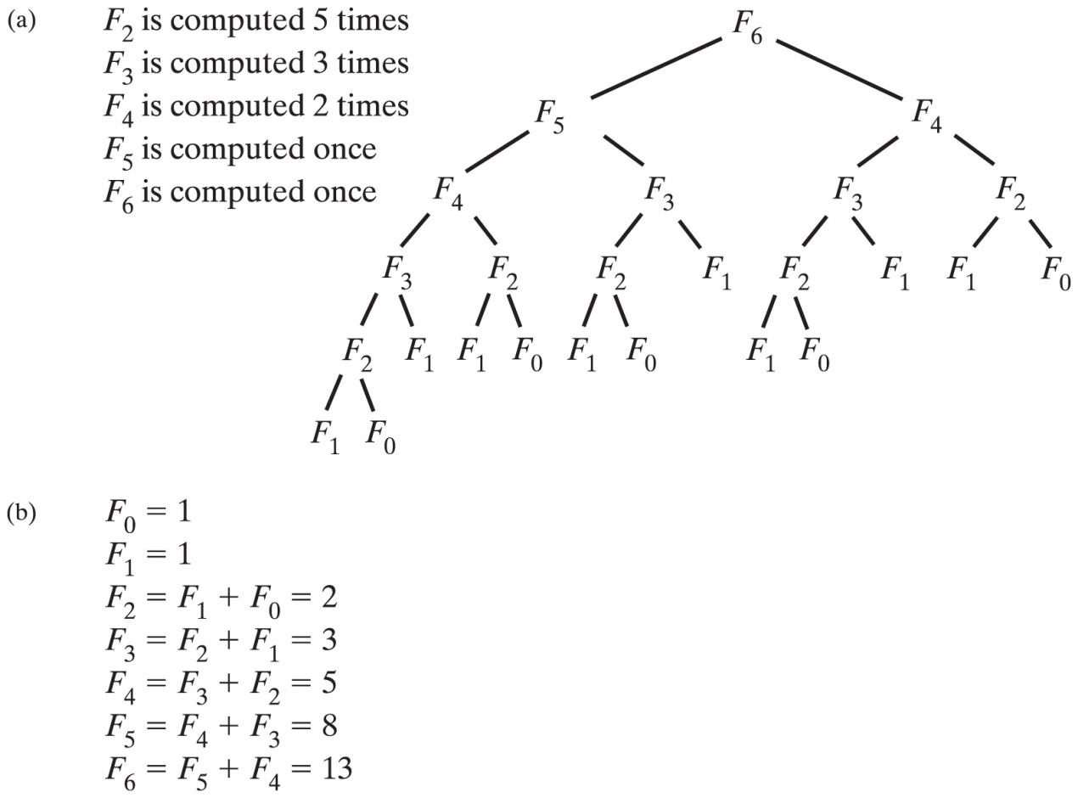
A Poor Solution to Simple Problem - Fibonacci
Download iterative and recursive algo from MEL
Time efficiency grows exponentially with n!
Carrano, Data Structures and Abstractions with Java, Second Edition, (c) 2007 Pearson Education, Inc. All rights reserved. 0-13-237045-X

Slide 25
4. Recursion in Array Processing
Recursive processing of an array:
Divide the array into two pieces repetitively
e.g.
Problem: Searching for maximum in array
Recursive Solution:
if (anArray has only one item)
maxArray(anArray) is the item in anArray
else if (anArray has more than one item)
maxArray(anArray) is the maximum of
maxArray(left half of anArray) and
maxArray(right half of anArray)

Slide 26
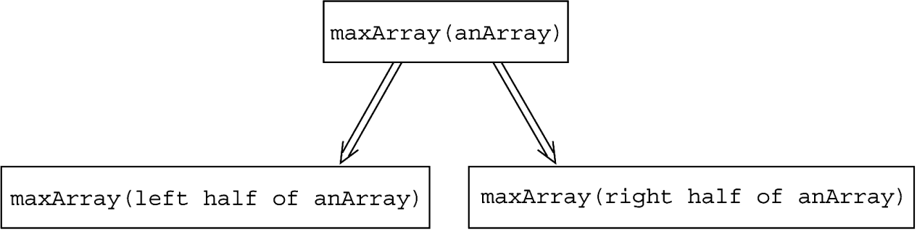
Recursion in Array Processing
Recursive processing of an array:
Copyright © 2007 Pearson Education, Inc. Publishing as Pearson Addison-Wesley. Ver. 5.0.

Slide 27
Recursion in Array Processing
How is the recursive solution different from Binary search?
Binary Search:
binarySearch(in anArray:ArrayType, in value:ItemType)
if (anArray is of size 1)
Determine if anArray’s item is equal to value
else
{
Find the midpoint of anArray
Determine which half of anArray contains value
if (value is in the first half of anArray) binarySearch(first half of anArray, value)
else
binarySearch(second half of anArray, value)
}
Binary search conquers only one of its subproblems at each step
Recursive solution for finding max whereas conquers both.
In addition, after recursive solution conquers the subproblems, it
must reconcile the two solutions (ie. Find max of the two
maxima)

Slide 28
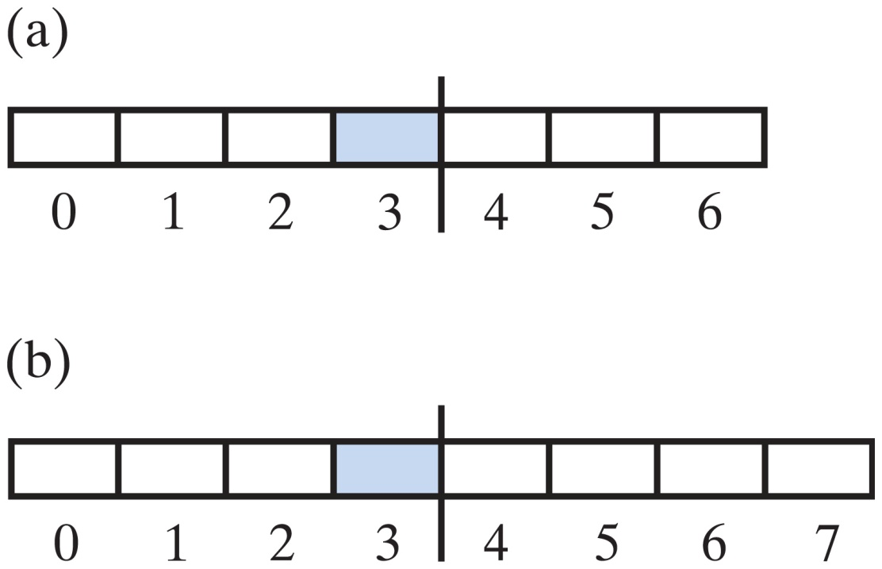
Recursion in Array Processing
Two arrays with middle elements within left halves
Carrano, Data Structures and Abstractions with Java, Second Edition, (c) 2007 Pearson Education, Inc. All rights reserved. 0-13-237045-X

Slide 29
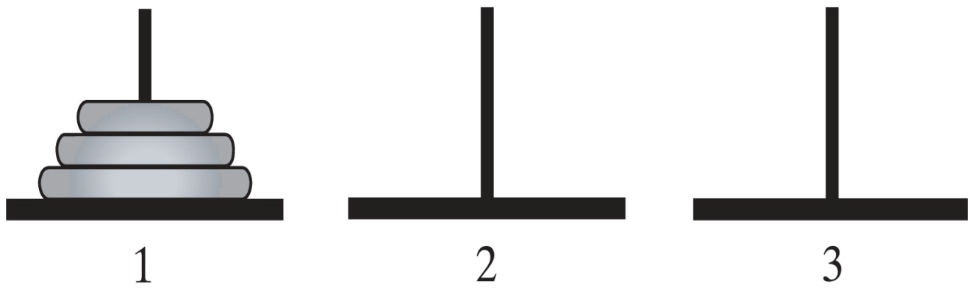
5. A Simple Solution to a Problem– Tower of Hanoi
Problem:
Tower of Hanoi
Given n disks of different sizes and three poles 1, 2, 3,
how to move all the disks from 1 to 3, using pole 2 as a
spare?
Carrano, Data Structures and Abstractions with Java, Second Edition, (c) 2007 Pearson Education, Inc. All rights reserved. 0-13-237045-X

Slide 30
A Simple Solution to a Problem– Tower of Hanoi
Rules for the Towers of Hanoi game
Move one disk at a time. Each disk you move must be a topmost disk.
No disk may rest on top of a disk smaller than itself.
You can store disks on the second pole temporarily, as long as you observe the previous two rules.
Carrano, Data Structures and Abstractions with Java, Second Edition, (c) 2007 Pearson Education, Inc. All rights reserved. 0-13-237045-X

Slide 31
A Simple Solution to a Problem – Tower of Hanoi
Major steps:
If only 1 disc (i.e. n = 1), move it from pole 1 to 3
If more than 1 disc (i.e. n > 1)
Ignore the bottom disc and solve the problem for n – 1 discs with the small modification that pole 2 is the destination and pole 3 is the spare
After the above, n – 1 discs will be on pole 2 and the largest disc is on pole 1. So solve the problem for n-1 by moving the largest disc from pole 1 to 3
Proceed to move the n-1 discs from pole 2 to pole 3, i.e. solve the problem with pole 2 as the source, pole 3 as destination and pole 1 as spare.

Slide 32
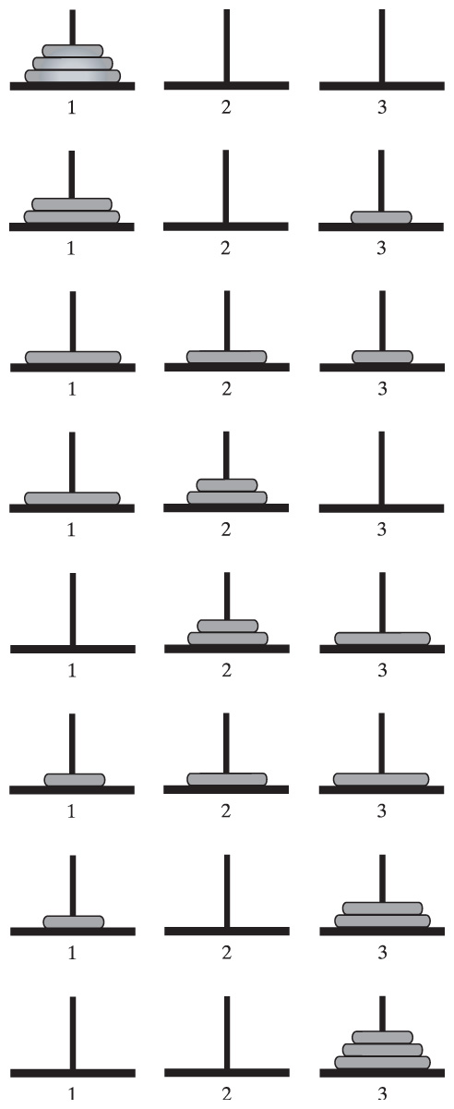
A Simple Solution to a Problem– Tower of Hanoi
Carrano, Data Structures and Abstractions with Java, Second Edition, (c) 2007 Pearson Education, Inc. All rights reserved. 0-13-237045-X

Slide 33
A Simple Solution to a Problem– Tower of Hanoi
See Tower of Hanoi Animation slides
Carrano, Data Structures and Abstractions with Java, Second Edition, (c) 2007 Pearson Education, Inc. All rights reserved. 0-13-237045-X

Slide 34
A Simple Solution to a Problem – Tower of Hanoi
Recursive solution for Tower of Hanoi
solveTowers(count, source, destination, spare)
{
if (count is 1)
Move a disk directly from source to
destination
else
{
solveTowers(count-1, source, spare, destination)
solveTowers(1, source, destination, spare)
solveTowers(count-1, spare, destination,
source)
} //end if
}
Try other number of discs: http://towersofhanoi.info/Animate.aspx

Slide 35
6. Recursion and Efficiency
Some recursive solutions are so inefficient that they should not be used
Factors that contribute to the inefficiency of some recursive solutions
Overhead associated with function calls
(an initial call to function can generate a large no. of recursive calls -> magnify the cost in context switching)
Inherent inefficiency of some recursive algorithms
(possibly due to recomputation of same values repetitively for e.g. for rabbit (7), rabbit(3) is computed 5 times.)

Slide 36
Recursion and Efficiency
Thus an iterative solution can be more efficient than recursive solution.
In some cases, however easier to discover a recursive solution ->need to convert to iterative solution if more efficient

Slide 37
Recursion and Efficiency
Converting a recursive solution to iterative solution is easier when there is tail recursion
Tail Recursion
Occurs when the last action performed by a recursive method is a recursive call
void countDown(int i)
{
cout << i;
if(i > 1)
countDown(i – 1);
} // end
There is no pending operation to be performed after return from recursive call
Usually returns the value of the last recursive call as value of the function

Slide 38
Recursion and Efficiency
If no tail recursion, information needs to be stored across recursive steps
int findFact(int n)
{
if (n <= 1)
return 1;
else
return n * findFact(n - 1);
} // end fact
Information about each pending operation must be stored
=>dependent on the no. of recursive calls

Slide 39
Recursion and Efficiency
Solution1: Convert to Tail Recursion
By passing in whatever information needed at any step as a parameter to the recursive method rather than stored at a higher level.
void findFact(int n, int &result)
{
if (n <= 1)
return;
else
findFact(n - 1, n * result);
} // end fact
Notice that no pending operation on return from recursive calls!!

Slide 40
Recursion and Efficiency
Consider the case of findFact(4, result) where result is a variable initialized with value 1.
Upon return, result stores 24 (= 4 x 3 x 2 x 1)
findFact(4, result)
result stores 1
findFact(3, 4 * result)
result stores 1
findFact(2, 3 * result)
result stores 4
findFact(1, 2 * result)
result stores 12
result stores 24
return

Slide 41
Recursion and Efficiency
Solution2: Convert to Iterative Version
int findFact(int n)
{
int result = 1;
for(int i = n ; i >= 1; i--)
result *= i;
return result;
} // end fact
Tail recursion can be converted to iterative version usually quite easily.

Slide 42
Recursion and Efficiency
Besides the time inefficiency involved in having to switch between different contexts/local environment,
Recursion consumes much memory space as well:
A recursive method can issue many recursive calls
Need to store activation record in program stack for each recursive call

Slide 43
Recursion VS Iteration
Iteration | Recursion
Repetition control structure | Selection control structure
Involve repetition | Involve repetition
Achieves repetition through repetition control structure | Achieves repetition through repetitive function calls
Terminates when loop continuation condition fails | Terminates when base case is reached.
Mechanism involves constant modification of counter | Mechanism involves divide and conquer
Infinite iteration when loop continuation condition is always true | Infinite Recursion when problem is not reduced in such way that converges on the base case

Slide 44
Summary
Introduction of Recursion
Constructing Recursive Solutions
A Poor Solution to a Simple Problem
Recursion in Array Processing
A Simple Solution to a Difficult Problem
Recursion and Efficiency
Recursion VS Iteration

